Slide 1
Engaged in School
Career Ready
Notes:
Recommended reports
Pathways to Prosperity, Harvard Graduate School of Education (Feb, 2011)
Across the Great Divide: Perspectives of CEOs and College Presidents on America's Higher Education and Skills Gap, Civic Enterprises & Corporate Voices for Working Families (March, 2011)
College Completion Toolkit, USDOE (March, 2011)
Are They Really Ready to Work? Employers’ Perspectives on the Basic Knowledge and Applied Skills of New Entrants to the 21st Century U.S. Workforce, The Conference Board, Corporate Voices for Working Families, the Partnership for 21st Century Skills, and the Society for Human Resource Management (2006)
California’s Forgotten Middle Skills Jobs: Meeting the Demands of a 21st-Century Economy (October 2009)

Slide 2
Student Centered Career Readiness
Being career ready means, in part, that a high school graduate has a viable postsecondary plan with, at least initial occupational goals, and understands the steps necessary to achieve those goals.
Plan development requires an understanding of:
Who Am I?
Where Am I Going?
How Do I Get There?

Slide 3
Engaged Imaginations
Einstein said:
“imagination is more important
than information or knowledge,”
Information is essential, but insufficient.
When we can visualize ourselves in appealing future scenarios (vacation, career…), a spark is ignited.
We become purposeful and intentional in the present to create the future we want.

Slide 4
CalCRN Resources Linking Information & Imagination
CaliforniaCareers.info
California Career Center
California CareerZone
California Reality Check
California Career Planning Guide
Support Personnel Accountability Report Card (SPARC)
The Real Game California TM (TRGC 2.1)

Slide 5
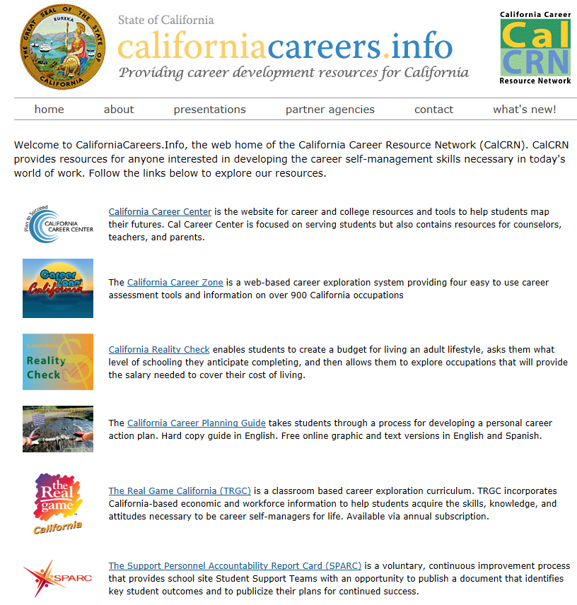

Slide 6
www.CaliforniaCareers.info
CalCRN Home Page
Links to all CalCRN resources
State Agency Partner links
Presentations inc Power Point and Reports
What’s New inc Meeting Schedule

Slide 7
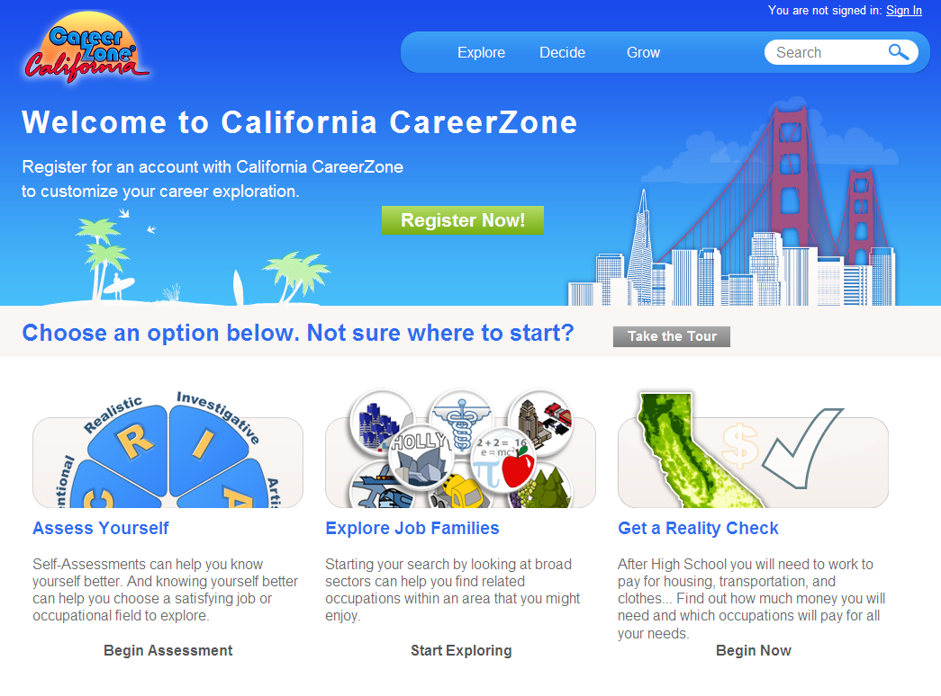
www.cacareerzone.org

Slide 8
California CareerZone
Four Assessments:
Quick Assessment (Holland)
Interest Profiler (Holland)
Work Importance Profiler
Skills Profiler
900 Occupations (300 with videos)
7418 Postsecondary Schools (NCES)
Online Account Option
Educator Class Management (New)
Workbook PDF
Notes:
The RIASEC model says that there are six types of people and six corresponding environments.
People are attracted to environments that correspond with their interests.
The Six Basic Ideas of Holland’s Theory:
1. Most people can be classified as one of six personality types: Realistic (R),
Investigative (I), Artistic (A), Social (S), Enterprising (E), and Conventional (C).
2. People of the same personality working together create an environment that fits their type. For example, Social types create a Social environment;
3. There are six basic types of environments: Realistic (R), Investigative (I), Artistic (A), Social (S), Enterprising (E), and Conventional (C);
4. People search for environments where they can use their skills and abilities and
express their values and attitudes;
5. People who choose to study and work in an environment similar to their personality
type are more likely to be successful and satisfied; and
6. How you act and feel depends to a large extent on your school or work environment.

Slide 9
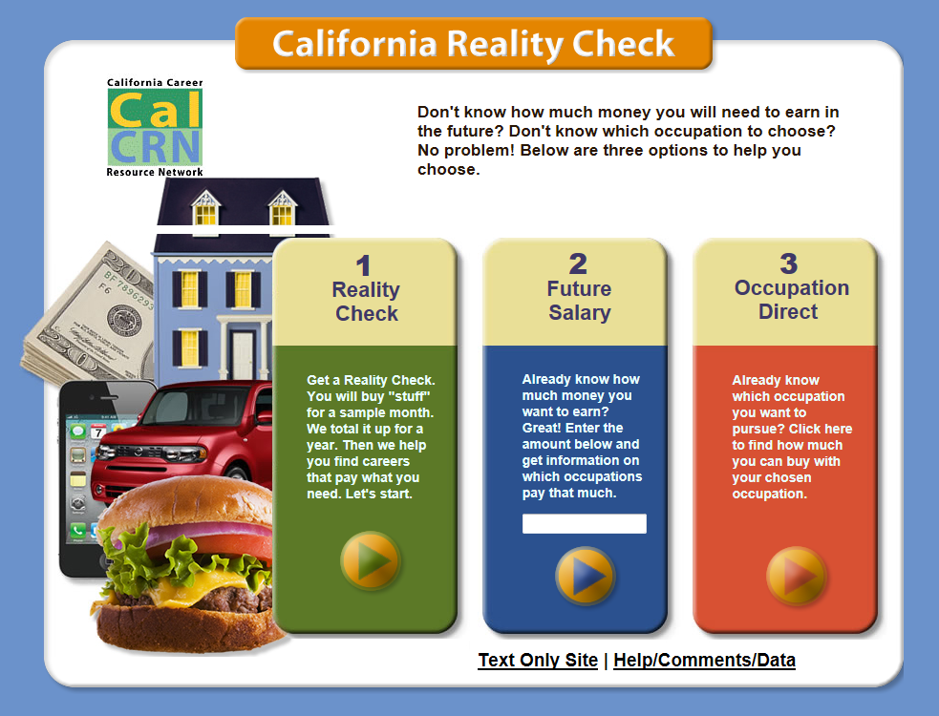
www.californiarealitycheck.com

Slide 10
California Reality Check
Build a Budget in one of 22 California Cities by selecting:
Housing
Utilities
Food
Transportation
Clothing
Health Care
Personal
Entertainment
Misc
Savings
Student Loan Debt
Taxes
Choose an Education Level
Choose an Occupational category
Explore Occupations
Family Cost
Workbook available
Notes:
10
Reality Check Data Sources
HOUSING
Purchase - Zillow.com.
Rent - HUD data, specifically, 50th Percentile Rents.
UTILITIES
For electricity and phone - ACCRA Data for the cities listed - statewide average for those not listed.
Other utilities the data is the same for all cities associations or foundations that conduct a national survey.
Mobile phone - CTIA, The International Association for the Wireless Telecommunications.
Cable TV data - National Cable & Telecommunications Association and their annual survey.
Internet/DSL - Pew Internet & American Life Project.
FOOD - Averages
TRANSPORTATION
Individual city sites and from Edmunds.com
Bus Data - cost of a monthly pass for each city’s major public transportation.
Data for each auto type is from Edmunds.com and comes from their 'True Cost To Own".
CLOTHES - Averages
HEALTH CARE
Health Care insurance - Kaiser Family Foundation from the Employer Health Benefits 2009 Annual Survey. This data will be the same for all cities.
Doctor’s Visit and Dentist Visit - ACCRA and statewide average is provided for cities not listed.
ENTERTAINMENT - Averages
FAMILY PLAN
United States Department of Agriculture (USDA) Center for Nutrition Policy and Promotion, Expenditures on Children by Families, 2008, their most recent report. The data will be the same for all cities.

Slide 11
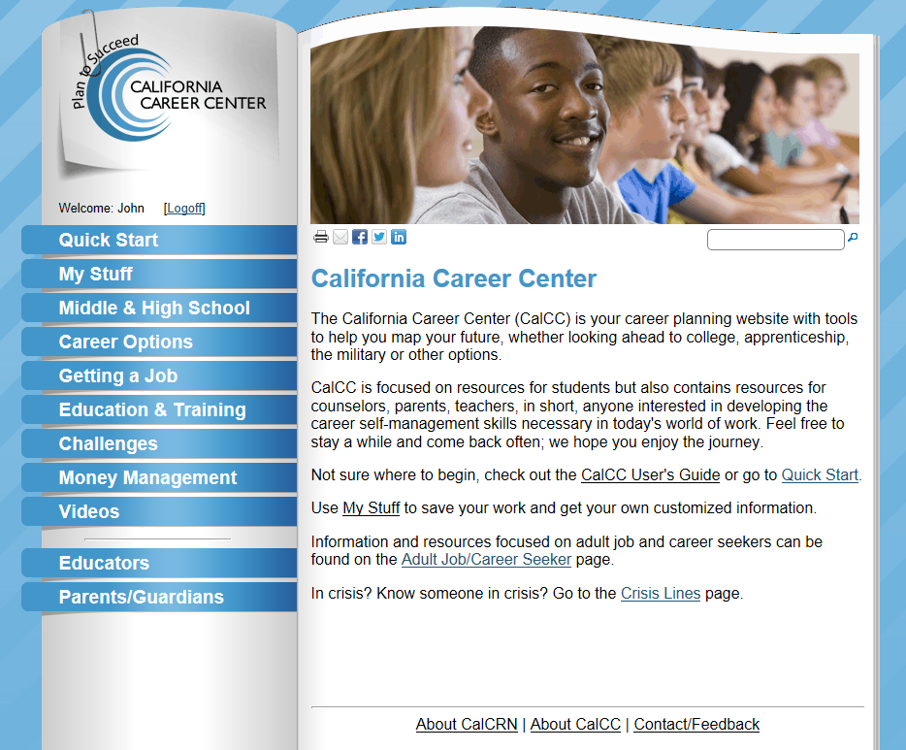
www.calcareercenter.org

Slide 12
California Career Center
Student Centered
Quick Start
My Stuff
Middle & High School
Career Options
Education & Training
Getting A Job
Challenges
Money Management
Videos
Also
Crisis Lines
CalCC Roadmap
Adult Job/Career Seeker
Educator Resources
Parent/Guardian Resources
Adding in 2013
Mobile application
Lesson Plans
Lesson Plan Wizard

Slide 14
California Career Planning Guide Contents Summary
Introduction to the Career Planning Process
Learn About Yourself
Investigate the World of Work
Use What You Have Learned
Test the Waters
Wrap It Up – Create a Career Action Plan
Additional resource links and online How-To Video, plus English, Spanish & text PDFs. We plan to have writable PDF worksheets available soon.

Slide 15
Notes:
Middle and high school classroom based career education curriculum
Students experience a simulated California adult life/work role to learn career self-management competencies.
TRGC is part of the internationally popular The Real Game SeriesTM being used in over 70,000 classrooms in eleven countries.
www.RealGameCalifornia.org

Slide 16
The Real Game California 2.1
Four Units - Twenty-two Sessions
Making a Living – Spin Game, Wish Lists, Role Profiles
Quality of Life – Time Budgeting, Financial Budgeting, Financial Literacy
Changes & Choices – Gender Equity, Job Loss, Disasters, Self-Employment
The Personal Journey – Self Understanding, Occupational Options, Life Planning
96 California Role Profiles
Facilitator’s Guide www.RealGameCalifornia.org
Notes:
Facilitator’s Guide
Every session includes:
Overview
Time
Learning Objectives
Performance Indicators
Materials
Preparation
Activities
Personal Reflection
Discussion Points
Optional Activity

Slide 17
California Career Resource Network Contact Information
John Merris-Coots
916-324-8151 jmerris@cde.ca.gov

